Slide 1
Fundamentals of Machine Learning
Prepared by
Prince Thomas

Slide 2
Chapter 1: Introduction to Machine Learning
Artificial Intelligence and Machine Learning
- What is Artificial Intelligence?
- Relationship between AI, Machine Learning, and Data Science
What is Machine Learning?
- Definition and Key Concepts (Features, Labels, Models, and Predictions)
- Machine Learning Pipeline (Data Collection, Preprocessing, Model Training)
Machine Applications
- Applications in Healthcare, Agriculture, Finance, and Robotics
Types of Machine Learning
- Supervised Learning
- Unsupervised Learning
- Reinforcement Learning

Slide 3
Artificial Intelligence and Machine Learning
What is Artificial Intelligence (AI)?
AI aims to develop machines that can mimic human cognitive functions like decision-making, problem-solving, and language understanding.
AI includes various fields such as Natural Language Processing (NLP), Computer Vision, Robotics, Machine Learning and Deep Learning.

Slide 4
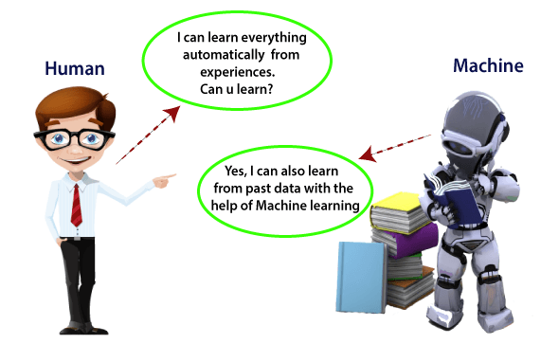
Machine learning enables a machine to automatically learn from data, improve performance from experiences, and predict things without being explicitly programmed.

Slide 5
Relationship between AI, ML, and Data Science
AI is the broader field covering any machine intelligence.
ML is a subset of AI where systems improve through experience with data.
Data Science involves collecting, cleaning, analyzing, and interpreting data; ML models often play a role in analysis and prediction.

Slide 6
What is Machine Learning?
Definition:
Machine Learning enables computers to automatically learn and adapt from experience without being explicitly programmed for every task.

Slide 7
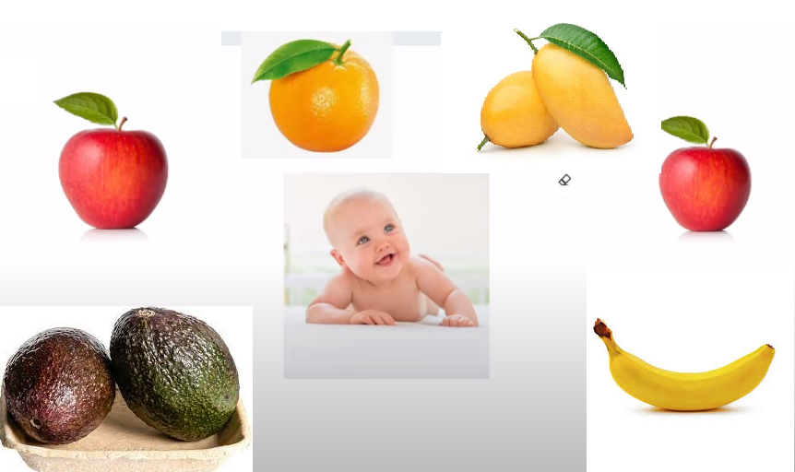
Classification is predicting the category or class of a new data based on its features.

Slide 8
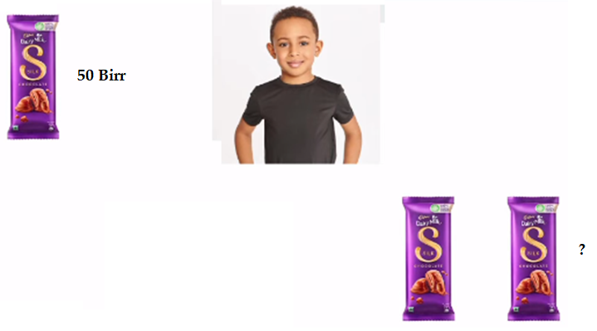
Answers gives exact number then this type of problem statements are called Regression.

Slide 9
Clustering is Grouping similar data points together based on their inherent characteristics(here based on colour and shape) or patterns.

Slide 10
Key Concepts of Machine Learning:
Features: The input variables or characteristics used by the model (e.g., patient age and blood pressure).
Labels: The output or target value the model predicts (e.g., ‘Disease Present’ or ‘Not Present’).
Model: A trained mathematical system (e.g., linear regression model or neural network) that processes features to generate predictions.
Predictions: The final output produced by the model based on input features (e.g., predicting crop yield or stock price).

Slide 11
Image classification:
Each image is labeled with a corresponding object or scene (e.g., "cat," "dog," "mountain").
Sentiment analysis:
Text data is labeled as positive, negative, or neutral.

Slide 12
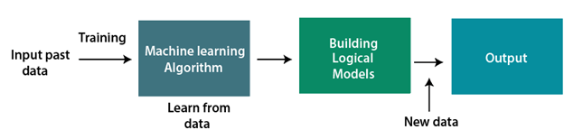
How does Machine Learning works

Slide 13
Cont.,
Machine learning works by developing algorithms and models that can learn from data and make predictions or decisions based on that data. The basic steps involved in machine learning are as follows:
1. Data collection: The first step in machine learning is to collect a large, diverse, and representative dataset of examples, along with some desired output or outcome for each example.
2. Data pre-processing: The next step is to preprocess the data to prepare it for use in the machine learning algorithm. This may involve tasks such as cleaning the data, removing outliers, and normalizing the data.
3. Feature engineering: Feature engineering involves selecting or extracting relevant features or attributes from the data that can be used to make predictions or decisions. This may involve tasks such as selecting the most important variables, transforming variables, or creating new features.

Slide 14
Cont.,
4. Model selection: The next step is to select an appropriate machine learning model or algorithm that is well-suited to the problem at hand. This may involve tasks such as selecting a classification algorithm, regression algorithm, or clustering algorithm.
5. Model training: Once a model has been selected, the next step is to train the model on the dataset. The model is adjusted or optimized to minimize the error or loss between the predicted output and the desired output.
6. Model evaluation: After training, the model is evaluated on a separate validation or test dataset to assess its performance and generalization ability. The model may be refined or adjusted based on the evaluation results.
7. Model deployment: Once the model has been trained and evaluated, it can be deployed in a real-world application to make predictions or decisions based on new, unseen data.

Slide 15
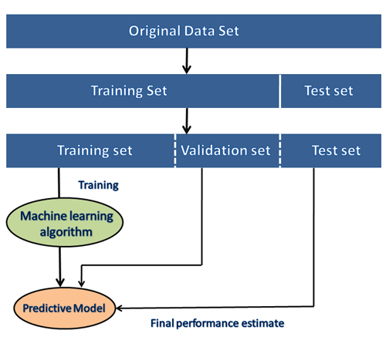
^{Dataset}
^{Original Dataset}
This is the complete dataset collected for the ML project.
Data Splitting
Training Set: Used to train the machine learning model
by fitting the algorithm to the data. Typically 60-80% of
the training set.
Validation Set: Used to tune hyperparameters (e.g., learning
rate) and prevent overfitting. Usually 10-20% of the original dataset.
Test Set: Used to evaluate the final performance of the trained model. The model is tested on this unseen data to assess its generalization ability. Typically 10-20% of the original dataset.

Slide 16
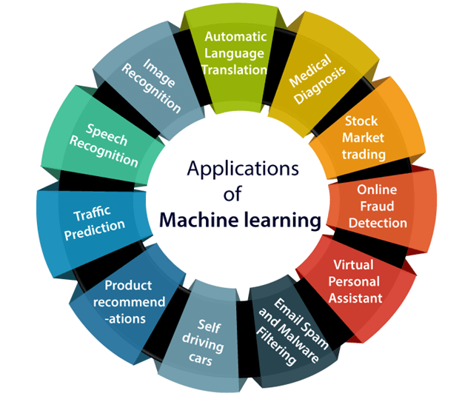
Applications of Machine learning

Slide 17
Types of Machine Learning
1. Supervised Learning
In supervised learning, models learn from labeled datasets, where each data point contains both features (input) and corresponding labels (correct output).
The objective is to predict the label for new, unseen data points using the patterns learned from the training data.
Example: Predicting Student Grades:
Features: Study hours, attendance
Label: Previous exam result (grade)
The model learns how study habits influence exam performance and predicts future grades for new students.

Slide 18
Common Algorithms:
Linear Regression: Predicts continuous values (e.g., house prices).
Decision Trees: Splits data based on features to classify or predict outcomes.
Neural Networks: Complex models inspired by the brain, useful for both regression and classification tasks (e.g., image recognition).
Applications:
Healthcare: Disease prediction (e.g., predicting diabetes).
Finance: Credit risk assessment.
Agriculture: Crop yield prediction.

Slide 19
2. Unsupervised Learning
In unsupervised learning, models work with unlabeled data, meaning the dataset contains only input features without predefined labels.
The model’s goal is to discover hidden patterns, structures, or relationships within the data.
Example: Customer Segmentation:
Using data on purchasing behavior (e.g., frequency of shopping, spending amount), the model groups customers into clusters to find patterns like “frequent shoppers” or “seasonal buyers.”

Slide 20
Common Algorithms:
K-Means Clustering: Groups data points into clusters based on feature similarity.
Principal Component Analysis (PCA): Reduces dimensionality of data while retaining essential patterns.
Applications:
Retail: Customer segmentation for personalized marketing.
Finance: Detecting unusual patterns in transactions (fraud detection).
Healthcare: Grouping patients based on symptoms for better diagnosis.

Slide 21
3. Reinforcement Learning
Reinforcement learning (RL) is a type of machine learning where an agent learns through interactions with the environment and receives rewards or penalties for its actions.
The goal is to develop an optimal strategy (policy) that maximizes cumulative rewards over time.
Example: Training a Robot to Walk:
The robot takes steps, receives rewards for maintaining balance, and penalties for falling.
Over time, the robot learns which actions maximize its stability and movement.

Slide 22
Common Algorithms:
Q-Learning: An RL algorithm that uses a Q-table to store and update the value of actions in each state.
Deep Q-Network (DQN): Combines deep learning with Q-learning to handle large, complex environments.
Applications:
Video Games: AI agents playing games like chess or Go.
Self-Driving Cars: Learning to navigate traffic safely.
Robotic Control: Training robots for industrial tasks (e.g., assembling parts).

